Slide 1
Software testing

Slide 2
The testing process
Component testing
  Testing of individual program components;
  Usually the responsibility of the component developer (except sometimes for critical systems);
  Tests are derived from the developer’s experience.
System testing
  Testing of groups of components integrated to create a system or sub-system;
  The responsibility of an independent testing team;
  Tests are based on a system specification.

Slide 3
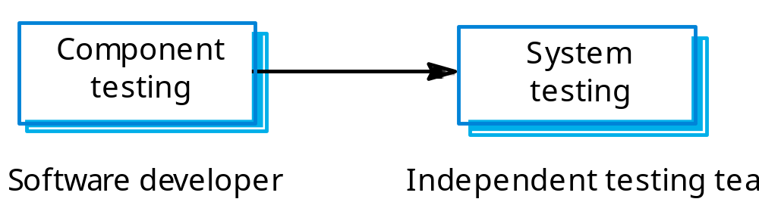
Testing phases

Slide 4
Defect testing
The goal of defect testing is to discover defects in programs
A successful defect test is a test which causes a program to behave in an anomalous way
Tests show the presence not the absence of defects

Slide 5
Testing process goals
Validation testing
  To demonstrate to the developer and the system customer that the software meets its requirements;
  A successful test shows that the system operates as intended.
Defect testing
  To discover faults or defects in the software where its behaviour is incorrect or not in conformance with its specification;
  A successful test is a test that makes the system perform incorrectly and so exposes a defect in the system.

Slide 6
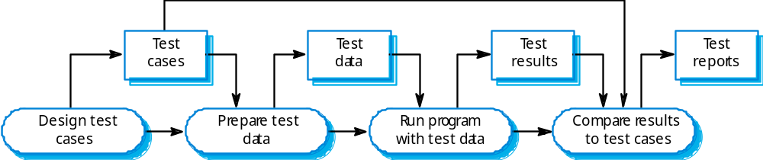
The software testing process

Slide 7
Testing policies
Only exhaustive testing can show a program is free from defects. However, exhaustive testing is impossible,
Testing policies define the approach to be used in selecting system tests:
  All functions accessed through menus should be tested;
  Combinations of functions accessed through the same menu should be tested;
  Where user input is required, all functions must be tested with correct and incorrect input.

Slide 8
System testing
Involves integrating components to create a system or sub-system.
May involve testing an increment to be delivered to the customer.
Two phases:
  Integration testing - the test team have access to the system source code. The system is tested as components are integrated.
  Release testing - the test team test the complete system to be delivered as a black-box.

Slide 9
Integration testing
Involves building a system from its components and testing it for problems that arise from component interactions.
Top-down integration
  Develop the skeleton of the system and populate it with components.
Bottom-up integration
  Integrate infrastructure components then add functional components.
To simplify error localisation, systems should be incrementally integrated.

Slide 10
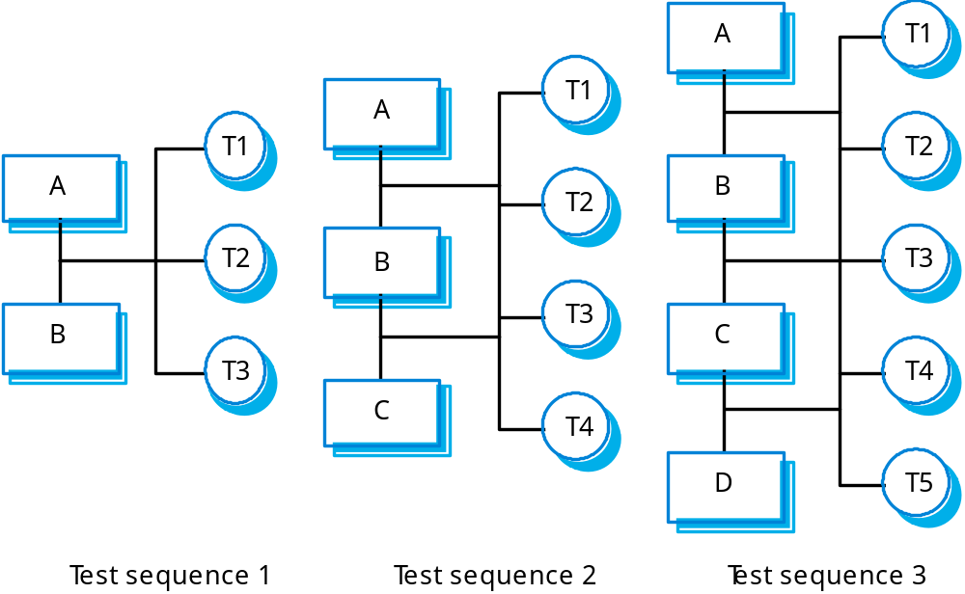
Incremental integration testing

Slide 11
Release testing
The process of testing a release of a system that will be distributed to customers.
Primary goal is to increase the supplier’s confidence that the system meets its requirements.
Release testing is usually black-box or functional testing
  Based on the system specification only;
  Testers do not have knowledge of the system implementation.

Slide 12
Testing guidelines
Testing guidelines are hints for the testing team to help them choose tests that will reveal defects in the system
  Choose inputs that force the system to generate all error messages;
  Design inputs that cause buffers to overflow;
  Repeat the same input or input series several times;
  Force invalid outputs to be generated;
  Force computation results to be too large or too small.

Slide 13
Performance testing
Part of release testing may involve testing the emergent properties of a system, such as performance and reliability.
Performance tests usually involve planning a series of tests where the load is steadily increased until the system performance becomes unacceptable.

Slide 14
Stress testing
Exercises the system beyond its maximum design load. Stressing the system often causes defects to
come to light.
Stressing the system test failure behaviour.. Systems should not fail catastrophically. Stress testing checks for unacceptable loss of service or data.
Stress testing is particularly relevant to distributed systems that can exhibit severe degradation as a
network becomes overloaded.

